Slide 1
Hotel Room Availability Prediction using Machine Learning
Machine Learning Project

Slide 2
Tharinda Nimnajith Rajapaksha Undergraduate at SLIIT AIE Machine Learning & Image Processing Course - Final Project

Slide 3
Introduction
Demand forecasting is a crucial part of hotel revenue management that aims to maximize revenue by matching demand to available capacity.
Specifically, short-term demand forecasts of four weeks or less before the target stay day have a critical impact on hotel revenue management operations such as pricing decisions and inventory control.

Slide 4
Used Technologies
Machine Learning Algorithm – Linear Regression Algorithm
Tkinter Library for creating the Graphical User Interface
Python 3.6
Other necessary python libraries such as pandas, numpy, pickle, scikit-learn, ctypes, dateutil and matplotlib etc.

Slide 5
Tkinter Library for GUI
Tkinter is the standard GUI library for Python.
Python when combined with Tkinter provides a fast and easy way to create GUI applications.
Tkinter provides a powerful object-oriented interface to the TkGUI toolkit.

Slide 6
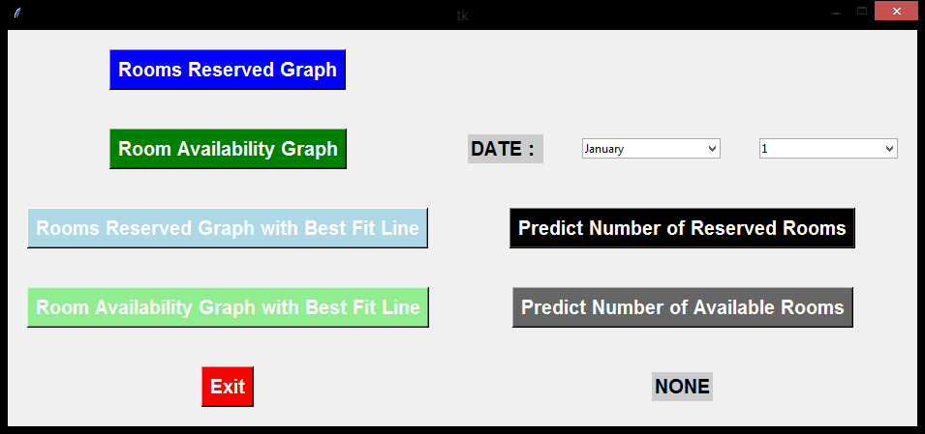

Slide 7
Linear Regression Algorithm
Regression is a method of modelling a target value based on independent predictors.
This method is mostly used for forecasting and finding out cause and effect relationship between variables.
Regression techniques mostly differ based on the number of independent variables and the type of relationship between the independent and dependent variables.

Slide 8
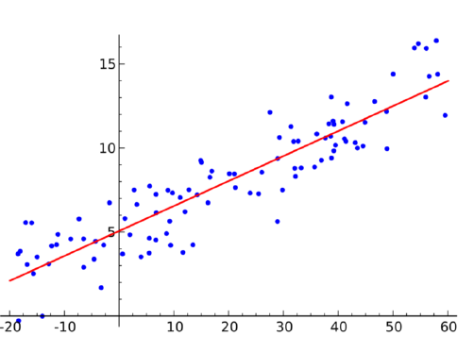

Slide 9
Simple linear regression is a type of regression analysis where the number of independent variables is one and there is a linear relationship between the independent (x) and dependent (y) variable.
y = m*x + c

Slide 10
Data Set
This dataset is collected from ABC hotel in Sri Lanka which contains 48 total number of rooms.
Training dataset: abc_hotel_train_data.csv
created_date : booking date
arrival_date : check in date
departure_date : check out date
room_type : type of the room
room_ocp_type : occupancy type of the room
meal_plan : meal plan of the customer
country : customer origin

Slide 11
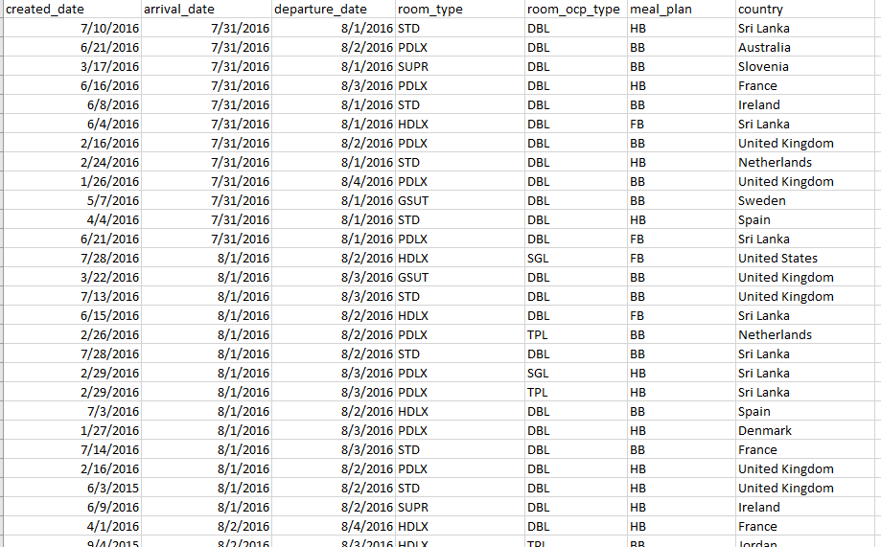

Slide 12
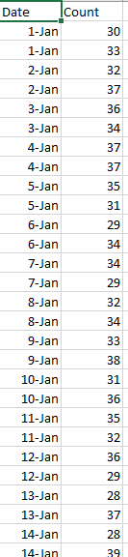
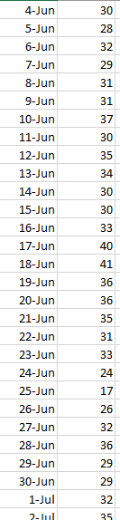
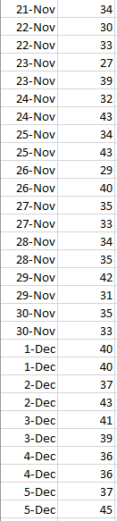

Slide 13
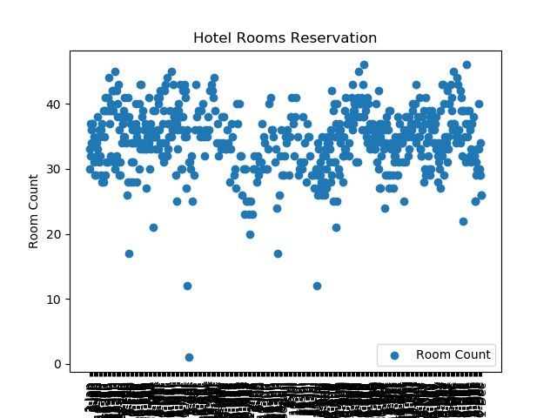

Slide 14
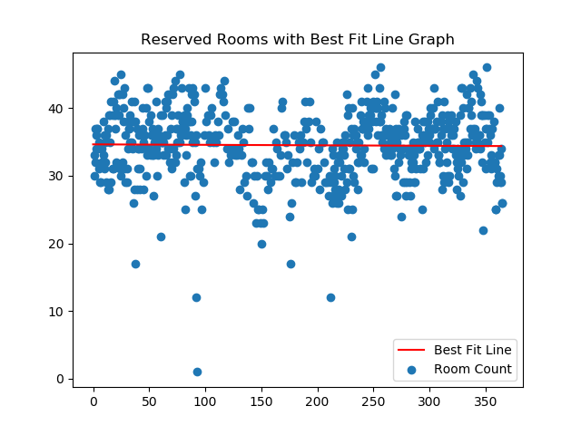

Slide 15
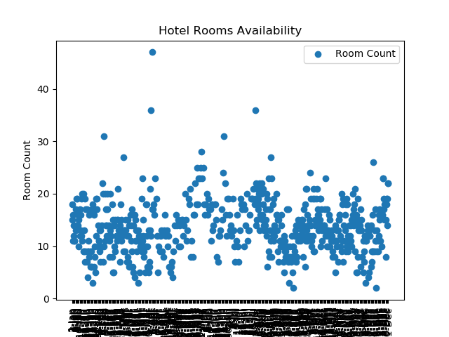

Slide 16
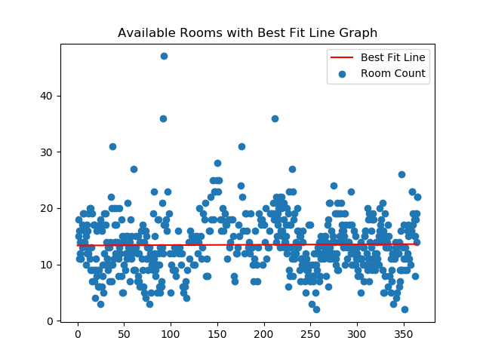

Slide 17
Future Plans for the project
More accuracy – Linear Regression for non-linear data
Effect of holidays on rooms reservations
Meal plans and Inventory control using predictions of room reservations
Monthly estimated outcome from room reservations

Slide 18
Thank You!

